Slide 1
ADRENERGIC ANTAGONISTS

Slide 2
ADRENERGIC ANTAGONISTS
Definition: Adrenergic Antagonists are pharmaceutical substances that act to inhibit the action of Catecholamines and those agents that mimic the sympathetic activities at the adrenergic receptors.
They can also be refer to as Adrenergic Blockers or Adrenoreceptor antagonists.
Adrenergic antagonist is a type of sympatholytic agent that is important and commonly used as medication.
It has opposite effect as Adrenergic Agonists and majorly divided into 2
1. Alpha (α) Blockers
2. Beta (β) Blockers

Slide 3
ALPHA ADRENERGIC ANTAGONISTS
Alpha Blockers or α-adrenergic antagonists are pharmacological agents that act as receptor antagonists of α-adrenoreceptors.
Alpha Blockers can be classified into α₁ and α₂ Blockers. The classification is based on the type of adrenoreceptors blocked by the agents.
When Alpha Blocker is used without classification ,it is sometimes refers to as α₁ blocker and sometimes refers to an agent that acts on both type of the receptors that is Non-selective Alpha Blocker.

Slide 4
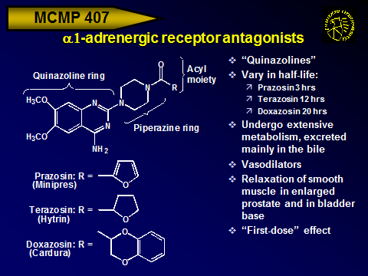
CLASSIFICATION OF ALPHA BLOCKERS
SELECTIVE ALPHA- ₁ BLOCKERS

Slide 5
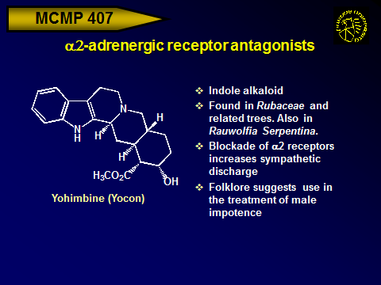
SELECTIVE ALPHA-₂ BLOCKERS
OTHERS INCLUDES: Indazoxan, Atipamezole,Mirtazapine

Slide 6
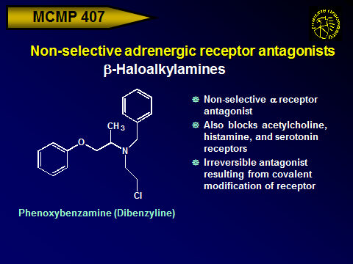
NON-SELECTIVE ALPHA-BLOCKERS

Slide 7
Non-selective adrenergic receptor antagonists
Imidazolines
Non-selective α receptor antagonist
Competitive (reversible) blocker
Potent vasodilator, but induces pronouced reflex tachycardia
Block of presynaptic α2 receptors may promote release of NE
Also blocks 5-HT receptors, and is a muscarinic and histamine receptor agonist
Phentolamine (Regitine)
OTHERS INCLUDE: Tolazoline,Trazodone,Typical and Atypical Anti-
Psychotics

Slide 8
MECHANISM OF ACTION OF ALPHA BLOCKERS
The effect of Alpha blocker is due to the blocking of post-synaptic alpha adrenoreceptors. This prevents Nor-epinephrine from acting on the receptors.
NOTE: The pre-synaptic α₂-adrenoreceptor is not affected , allowing the feedback inhibition of additional Nor-epinephrine release.

Slide 9
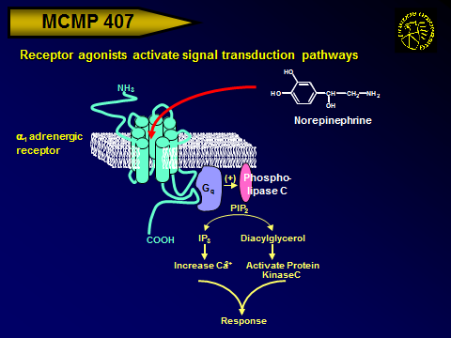

Slide 10
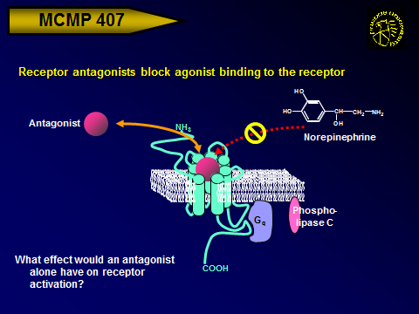

Slide 11
USES OF α-BLOCKERS
Alpha-Blocker is used in the treatment of several conditions such as Raynand`s disease ( a condition in which the blood vessels that supplies blood usually Toes and Fingers are narrowed.
It is also used in management of Hypertension in conjunction with diuretics when others are ineffective.
Also in Scleroderma (it is a disease that involve the hardening and tighting of the skin and connective tissues)
It can be used in the treatment of anxiety and panic disorder
It is used in the treatment of post traumatic stress disorder
Also often used to treat the symptoms of Benign Prostatic Hyperplasis (BPH).

Slide 12
SIDE EFFECTS
Alpha-Blockers have what is called “First dose effect” which usually occur when taken for the first time
Headache
Pounding heartbeat
Nausea
Weakness
Weight gain
Decrease in low-density lipoprotein(LDL) Cholesterol (Bad Cholesterol)
NOTE: Alpha Blockers can increase or decrease the effects of other medications.

Slide 13
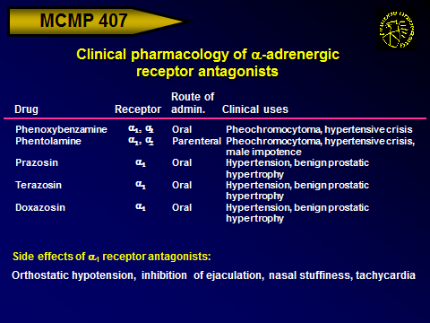

Slide 14
BETA – ADRENERGIC BLOCKER
Beta –blockers belong to a class of drugs that are particularly used for the management of Cardiac arrhythmias protecting the heart from a secondary heart
attack (myocardiac infraction) after the first heart attack( secondary prevention) and Hypertension.

Slide 15
CLASSIFICATIONS AND LOCATION OF BETA-RECEPTORS
The Beta receptor is divided into three based on their locations.
Beta₁- receptors located mainly in the heart and the Kidney
Beta₂- receptors located mainly in the lungs, Gastro intestinal tract(GIT),Liver, Uterus, Vascular smooth muscle and Skeletal muscle
Beta₃- receptors located in the Fat cells.
Beta blocker is divided into selective and non-selective Beta-blockers

Slide 16
MECHANISM OF ACTION OF BETA –BLOCKERS
It blocks the action of endogenous catecholamines; Epinephrine(Adrenaline) and Nor-epinephrine(Nor-adrenaline) in a particular beta adrenoreceptor of the sympathetic nervous system which mediate the flight and fight response.
β-blockers interfere with binding to the receptor of epinephrine and other stress hormones ,thus weaken the effect of stress hormones.

Slide 17
Effect of chronic β-receptor blockade
Na⁺
Presynaptic neuron
Na⁺
Tyrosine
Dopamine
Tyrosine
Action Potential
H⁺
MAO
DA
NE
NE
Ca²⁺
Uptake 1
Na⁺, Cl⁻
NE
NE
NE
NE
Effector organ

Slide 18
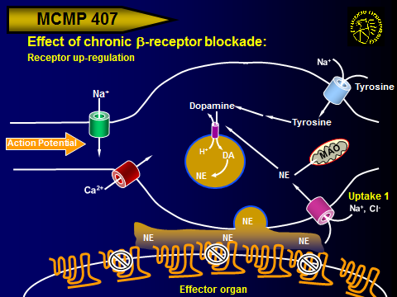

Slide 19
In 1962 Sir,James W.Black found the first clinically significant beta blockers ;Propranolol and Pronethalol.
This revolutionised the medical management of angina pectoris and is considered by many to be one of the most important contribution to Clinical Medicine and pharmacology of the 20th Century.

Slide 20
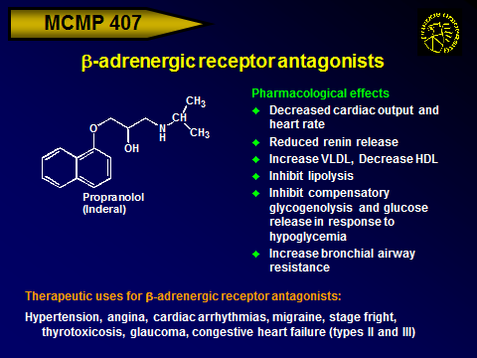
EXAMPLES OF BETA BLOCKERS

Slide 21
Non-selective β-adrenergic receptor antagonists
Less lipophilic than propranolol
Long half-life: ~20 hours
Mostly excreted unchanged in urine
Administered: Oral
Uses: Hypertension, angina, migraine
Nadolol (Corgard)
Thiadiazole nucleus with morpholine ring
Administered: Oral, Ophthalmic
Uses: Hypertension, angina, migraine, glaucoma
How will β-blockers affect
pupil size?
Timolol (Timoptic, Blocadren)

Slide 22
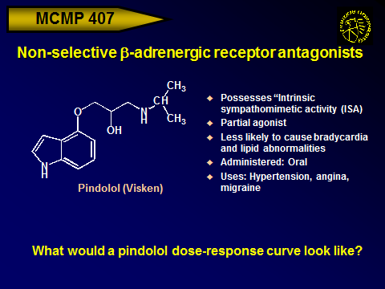

Slide 23
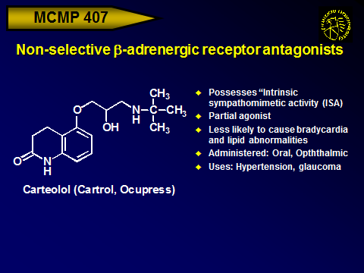

Slide 24
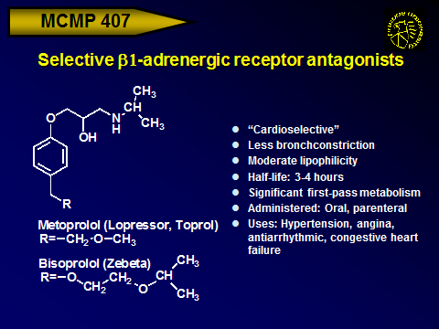
SELECTIVE BETA-₁ BLOCKERS

Slide 25
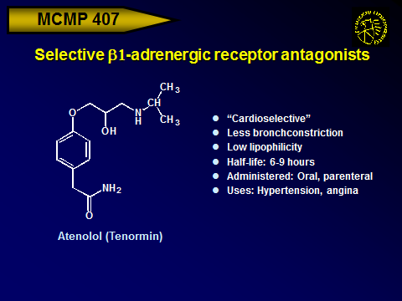

Slide 26
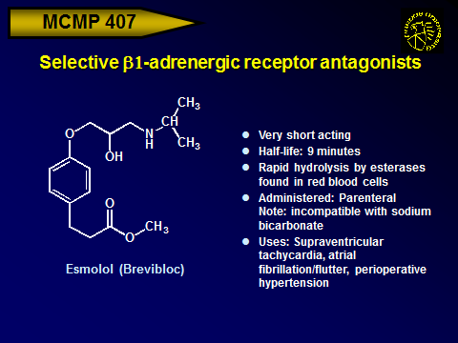

Slide 27
MEDICAL USES OF BETA BLOCKERS
Large differences exist in the pharmacology of the agents within the class, thus not all beta blockers are used for all medications listed below:
Angina Pectoris
Atrial fibrillation
Cardiac arrhythmia
Congestive heart failure
Essential tremor
Glaucoma
Hypertension
Migraine prophylaxis

Slide 28
MEDICAL USES OF BETA BLOCKERS CONT`D.
Mitral valve prolapse
Myocardial infraction
Postural orthostatic tachycardia syndrome
Symptomatic Control (Tachycardia tremor)
Anxiety and Hyperthyroidism
Theophylline overdose
Acute aortic dissection
Hypertrophic obstructive cardiomyopathy
Social and other anxiety disorders

Slide 29
ADVERSE DRUG REACTION
Nausea
Diarrhoea
Bronchospasm
Dyspnea
Cold extremities
Bradycardia
Hypertension
Heart Failure
Dizziness
Alopecia ( hair loss)
Fatigue
Abnormal vision
Insomnia
Hallucination
Nightmares
Sexual dysfunction
Erectile dysfunction
Alteration of Glucose and lipid metabolism
Peripheral vasoconstriction
Hypoglycemia

Slide 30
CONTRADICATIONS
In patients with Asthma
It is not use in patients with history of cocaine
It should not be used in first-line treatment in cocaine-induced acute coronary syndrome (CIACS)
TOXICITY
Glucagon is used in the treatment of overdose (it increases the strength of heart contraction and also increases intercellular cAMP
And decrease renal vascular resistance.
Salbutamol and isoprenaline can be used in beta- blocker poisoning.

Slide 31
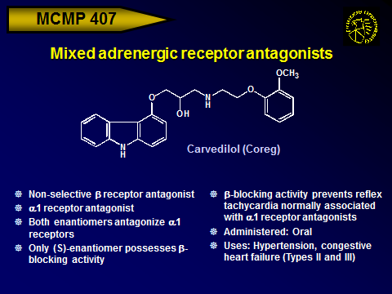
HOWEVER, SOME AGENTS ACT AS BOTH ALPHA AND BETA BLOCKERS
EXAMPLES ARE: Carvedilol and Labetalol

Slide 32
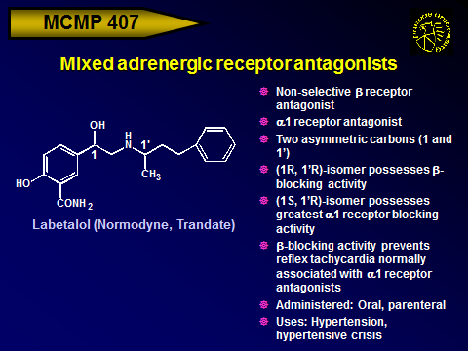

Slide 33
DO NOT GIVE UP
THE BEGINNNING IS ALWAYS HARDEST
THANKS FOR LISTENING

